Slide 1

Optimal Hotel Pricing using Machine Learning
Gannon University
Presented By: Megha Shah

Slide 2

Table of contents
Introduction
Objective
Problem Statement
Literature Review
Research Question
Methodology
Results
Evaluation
References

Slide 3
Introduction
Reliable demand forecasting is a critical component of revenue management in the hotel industry.
Traditionally in hotel demand forecasting, models such as times series, advance booking models, and other integrated models were frequently utilised which is now evolving towards the dynamic pricing strategy.
Dynamic pricing strategy is used to optimize the prices according to market trend and consumer data in order to attract more customers and increase revenue using AI & ML.

Slide 4
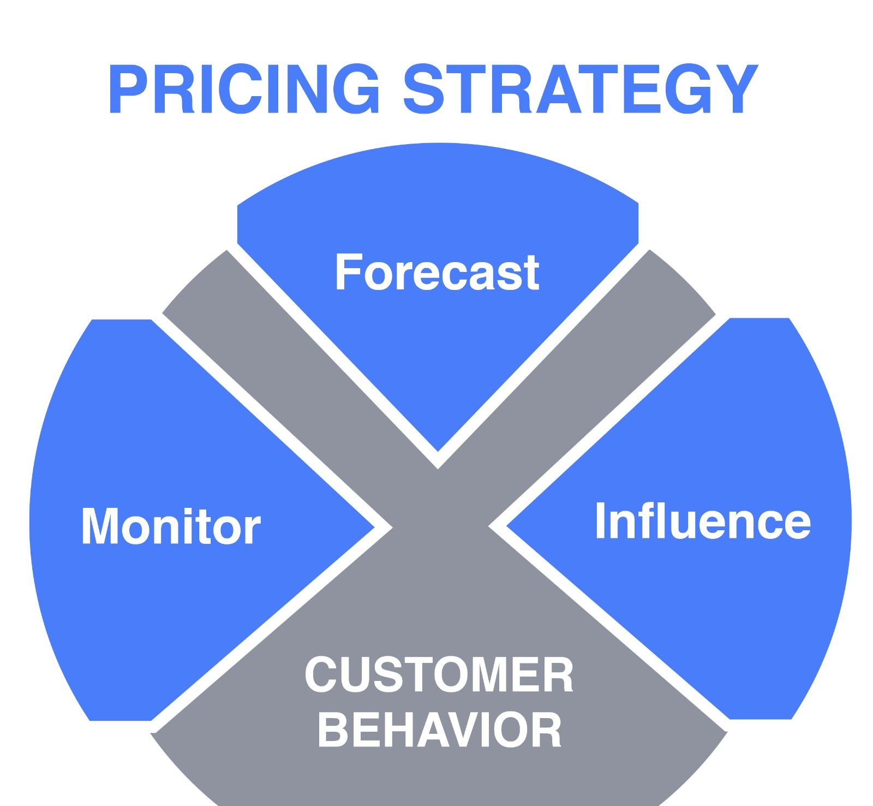
Objective
Find the factors that have direct impact on the hotel room rates.
Forecast the Customer behavior
To develop a dynamic pricing tool that calculates a daily price based on changing elements that influence the cost of reservations.

Slide 5
Problem Statement
Losing the hotel revenue because they are unable to capture the historical data from entire booking curve and failed to recognize optimum forecasting of hotel demand. (Ankit Raj, “Hotel Dynamic Pricing” 2019. Abigail A. Lorden, “2016 LODGING TECHNOLOGY STUDY” (2016)).

Slide 6
Literature review
Revenue management works best in transactions with fluctuating demand and relatively fixed, very unstable stocks (AnilBilgihanc, 2016).
Enhancing the customer experience and a hotel's profitability depend on being able to predict with accuracy how many rooms will be filled on any given night.
Every day, the potential vanishes since people are simultaneously generating and receiving consumer experience, which could go unnoticed [Zeithaml et al.]. One form of revenue management method is dynamic pricing.
The main objective of demand-based variable pricing in revenue management [S. Choi et al.,] which is based on a demand forecasting for each time ahead date, is to maximize profits.

Slide 7

Research Questions :
RQ1:
In relation to the customer (P), how will the machine learning model prioritize hotel amenities (I) in relation to other parameters (C) for optimal pricing to (O) retain the customer and make the hotel profitable(C) ?
RQ2:
With regards to previous customer demographics(P), how does the ML model adjust to the new demographics of the customer (I) compared to prior reports of demographics (C) for the model’s scalability (O) when the new demographic values are introduced (C)?

Slide 8
Methodology:
Data Collection:
The dataset highlights San Francisco's covered downtown location. In addition to the target attribute, there are 5207 samples and 28 other attributes.
Both categorical and numerical attributes are included in it.
Categorical attributes like amenities, room_type, cancellation_policy, etc.
Whereas numerical attributes like price, maximum_nights, number_of_reviews, etc.

Slide 9
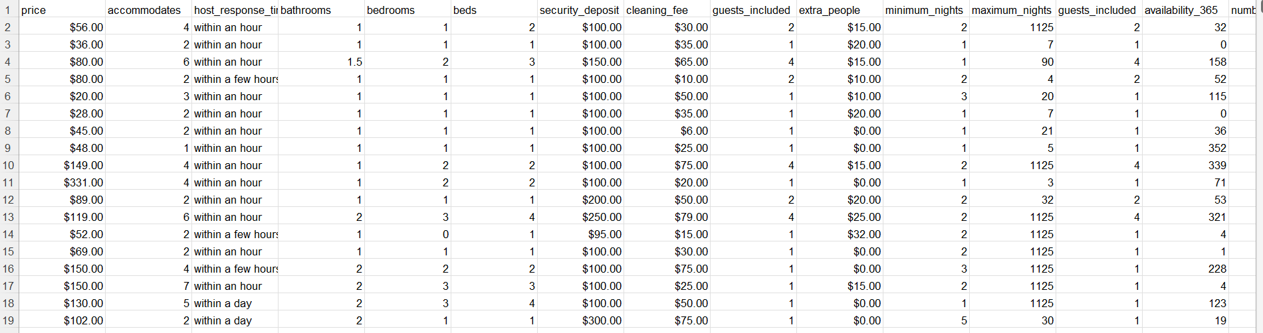
Dataset:

Slide 10
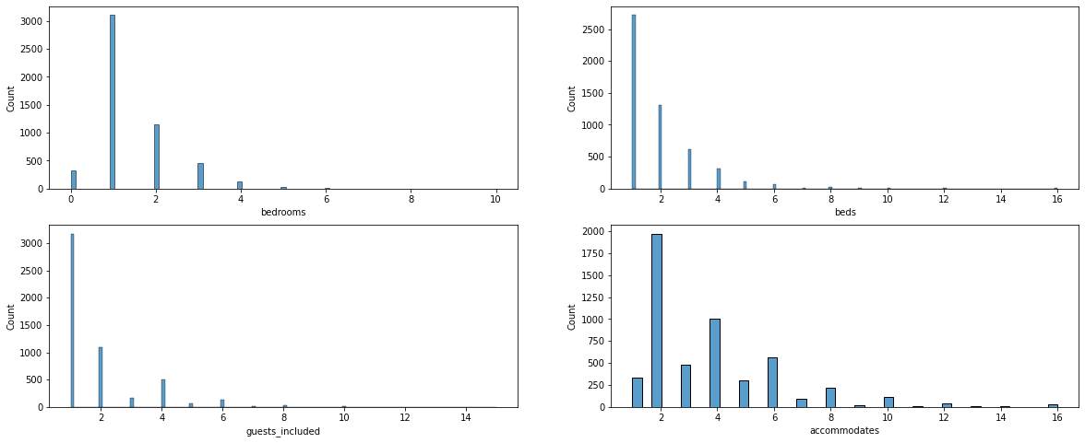
Data Preparation:
Clean the data and removed undesirable characters of the data.
We will check if the dataset have any missing values.
We will standardize the data by performing fit and transform method to fed into the model.

Slide 11
Data Analysis
We are using three machine learning algorithms to analyze the data. They are:
1. Random Forest regression Technique:
The Random Forest Regression technique is a supervised learning algorithm that uses an ensemble learning approach for regression.
In Random Forest we use row sampling & column sampling which will prevent from overfitting which improves the efficiency & accuracy of the model.
It is robust to the outlier.
2. Multi-Layer Perceptron Regression Technique:
An artificial neural network with three or more layers of perceptrons is called a multi-layer perceptron (MLP).
It effectively manages massive input data. following training, makes quick predictions.

Slide 12
Continue….
3. CatBoost Technique:
CatBoost expands on gradient boosting and decision tree theory.
The basic goal of boosting is to successively combine a large number of weak models, or models that just slightly outperform chance, in order to produce a strong, competitive predictive model through greedy search.

Slide 13
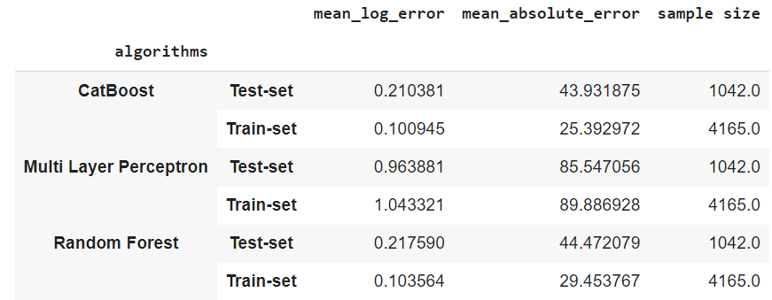
Result

Slide 14
Evaluation:
We are using Random Forest Algorithm and Multi layer perceptron and CatBoost to which is the best fit for this model.
The final stage entails running a few regression algorithms on the supplied data to generate dynamic hotel pricing.

Slide 15
References:
Abdel Aziz, H., Saleh, M., Rasmy, M. and El-Shishiny, H. (2011) Dynamic room pricing model for hotel revenue management systems. Egyptian Informatics Journal. 12(3):177-183.
Abigail A. Lorden, “2016 LODGING TECHNOLOGY STUDY” (2016)
Ankit Raj, “Hotel Dynamic Pricing” 2019
Eva Lacalle, “How can dynamic pricing improve your hotel revenue?” (26 Apr 2021)

Slide 16


